Slide 1
pose Estimation
Presented By :
2010030007 -Yashwanth
2010030481 - Tejaswini
2010030521 - Eshika
2010030532 - Sai kamal

Slide 2
TABLE OF CONTENTS
01.
02.
03.
Flow diagram
GitHub
Pre-processing Code
04.
05.
06.
MODEL
Model EVALUTION
CONCLUSION

Slide 3

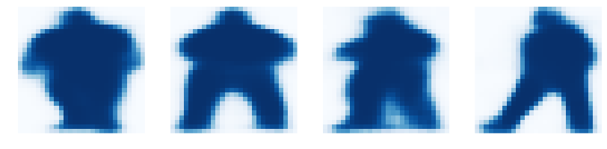
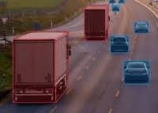
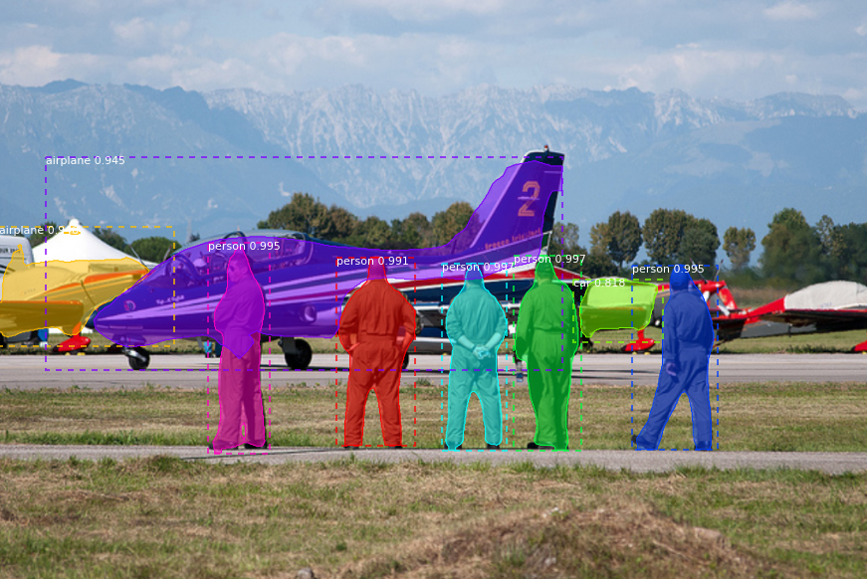
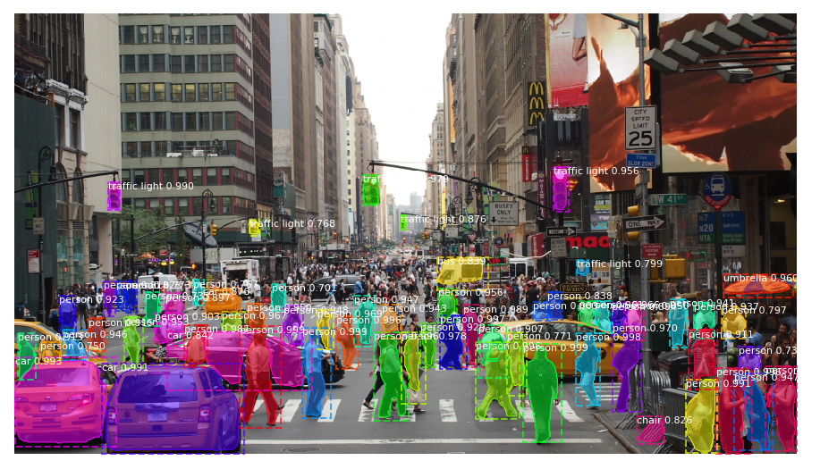
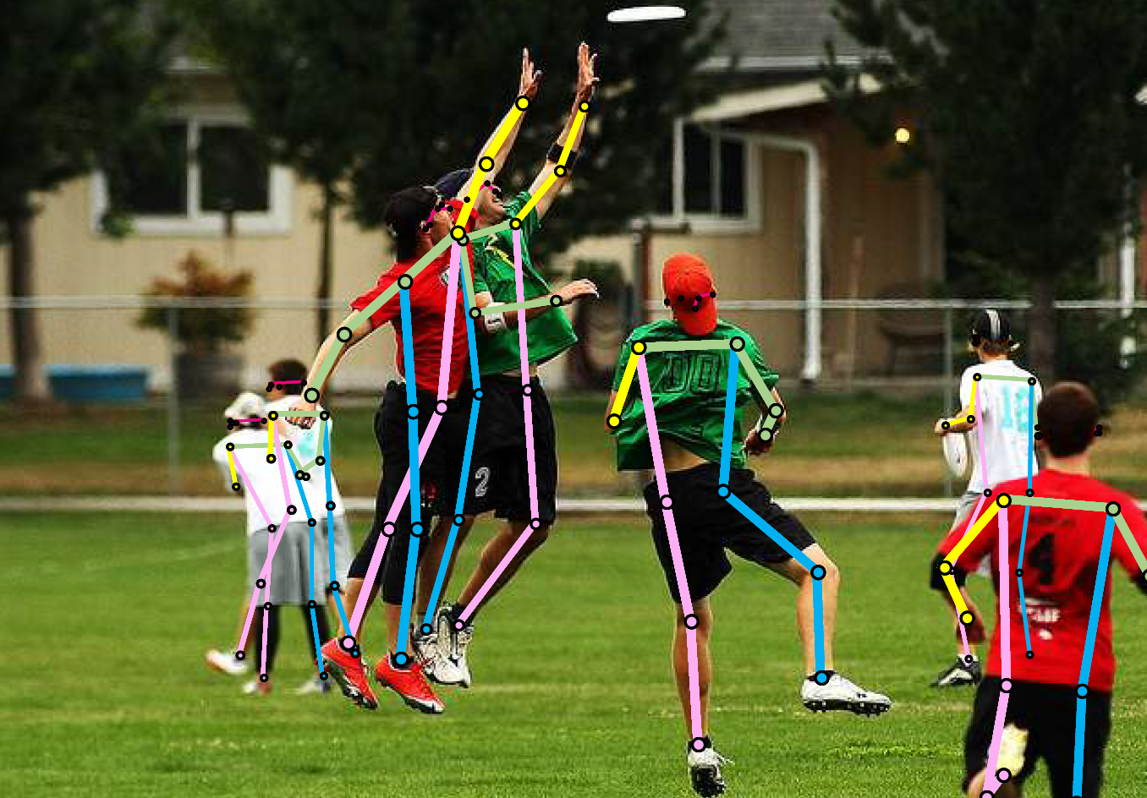
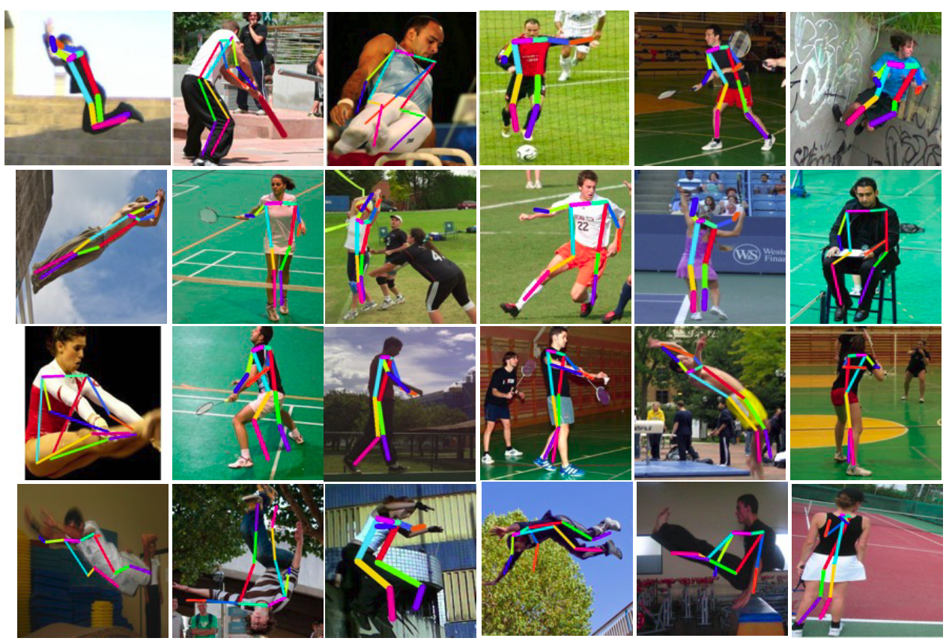
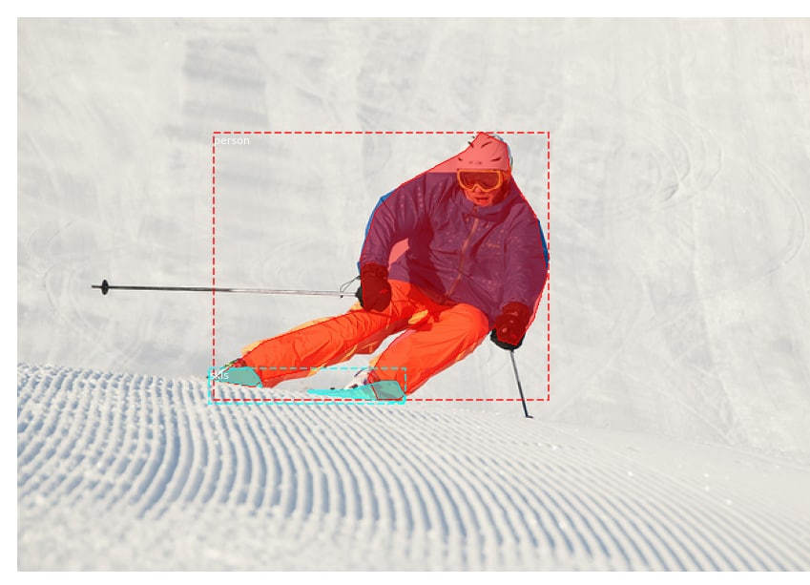
FLOW CHART
DATASET
DATASET PRE-PROCESSING
MODEL
MODEL EVALUTION
PROTOTYPE

Slide 4
DATASET
COCO DATASET:
The MS COCO (Microsoft Common Objects in Context) dataset is large-scale object detection, segmentation, key-point detection, and captioning dataset. The COCO dataset contains challenging, high-quality visual datasets for computer vision, mostly state-of-the-art neural networks. The dataset consists of 328K images.
Understanding visual scenes is a primary goal of computer vision; it involves recognizing what objects are present, localizing the objects in 2D and 3D, determining the object’s attributes, and characterizing the relationship between objects. Therefore, algorithms for object detection and object classification can be trained using the dataset.

Slide 5
DATASET
Pre-PROCESSING

Slide 6
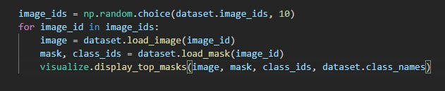
Mask Generation

Slide 7
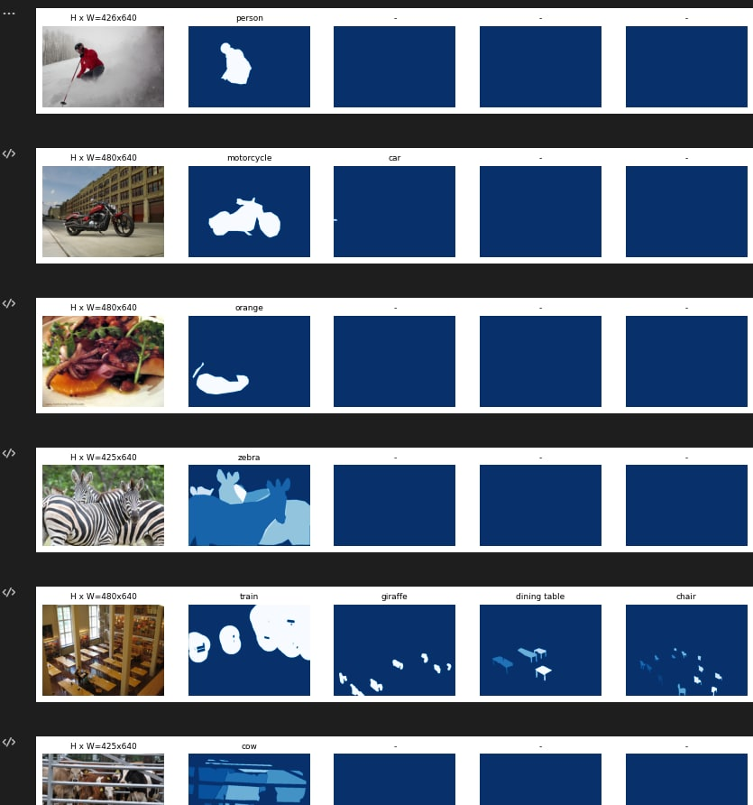

Slide 8
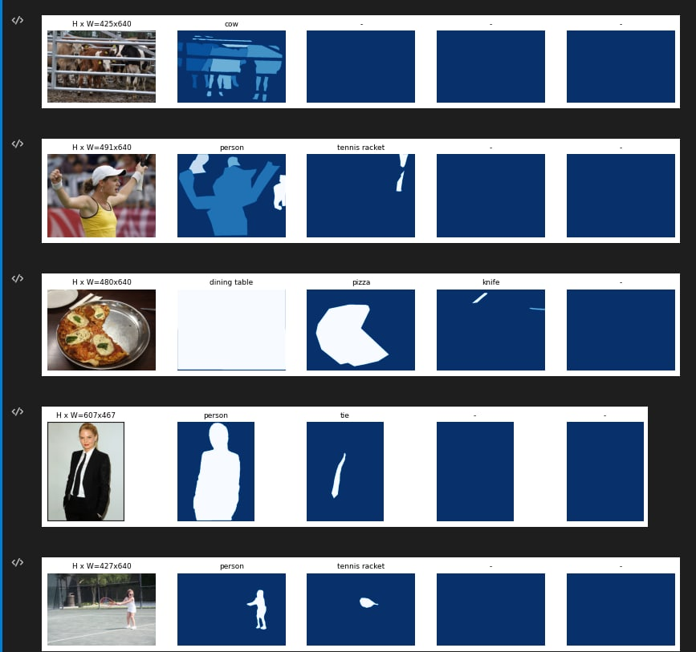

Slide 9
Bounding Boxes
Rather than using bounding box coordinates provided by the source datasets, we compute the bounding boxes from masks instead. This allows us to handle bounding boxes consistently regardless of the source dataset, and it also makes it easier to resize, rotate, or crop images because we simply generate the bounding boxes from the updates masks rather than computing bounding box transformation for each type of image transformation.

Slide 10
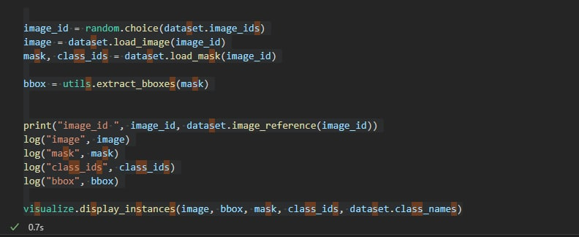

Slide 11
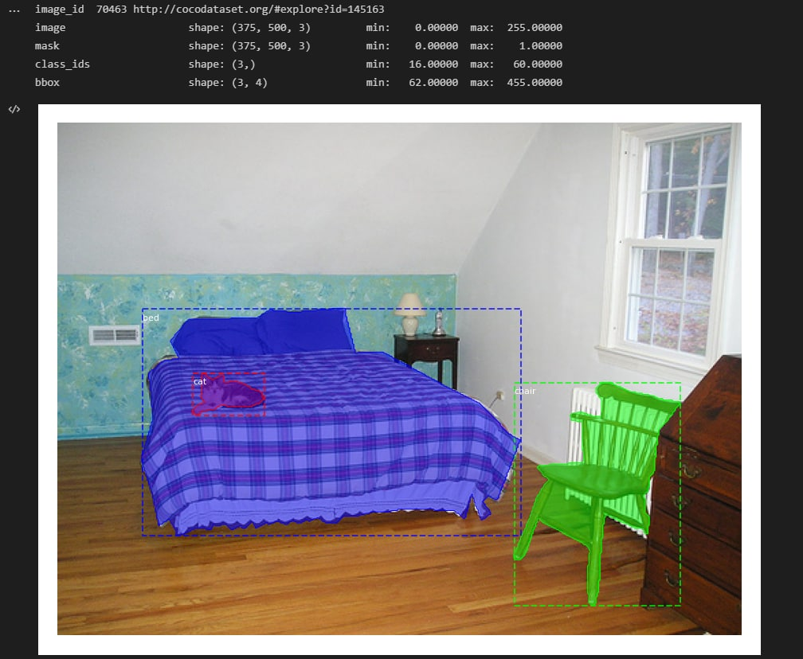

Slide 12
MODEL
MASK - RCNN
Mask R-CNN, or Mask RCNN, is a Convolutional Neural Network (CNN) and is state-of-the-art in terms of image segmentation and instance segmentation. Mask R-CNN was developed on top of Faster R-CNN, a Region-Based Convolutional Neural Network.
The computer vision task Image Segmentation is the process of partitioning a digital image into multiple segments (sets of pixels, also known as image objects). This segmentation is used to locate objects and boundaries (lines, curves, etc.)

Slide 13
# MS COCO Dataset
import coco
config = coco.CocoConfig()
COCO_DIR = r"C:\Users\sai kamal\AppData\Local\Programs\Python\Python310\Lib\site-packages\pycocotools\coco" # TODO: enter value here
# Load dataset
if config.NAME == 'shapes':
dataset = shapes.ShapesDataset()
dataset.load_shapes(500, config.IMAGE_SHAPE[0], config.IMAGE_SHAPE[1])
elif config.NAME == "coco":
dataset = coco.CocoDataset()
dataset.load_coco(COCO_DIR,"train")
# Must call before using the dataset
dataset.prepare()
print("Image Count: {}".format(len(dataset.image_ids)))
print("Class Count: {}".format(dataset.num_classes))
for i, info in enumerate(dataset.class_info):
print("{:3}. {:50}".format(i, info['name']))
CODE

Slide 14
PROTOTYPE

Slide 15
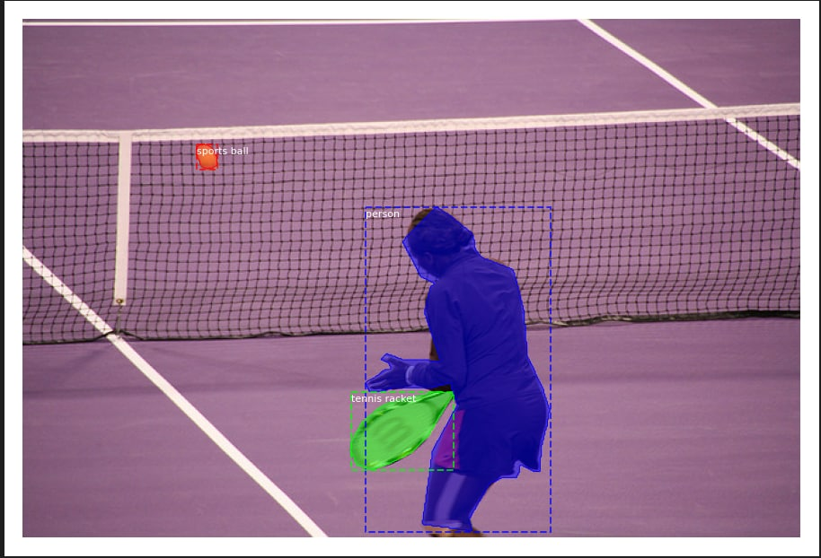
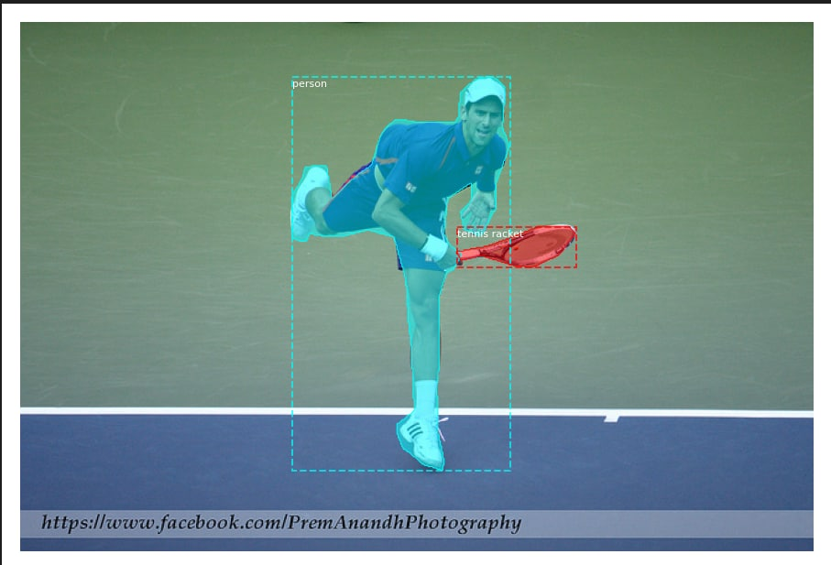

Slide 16
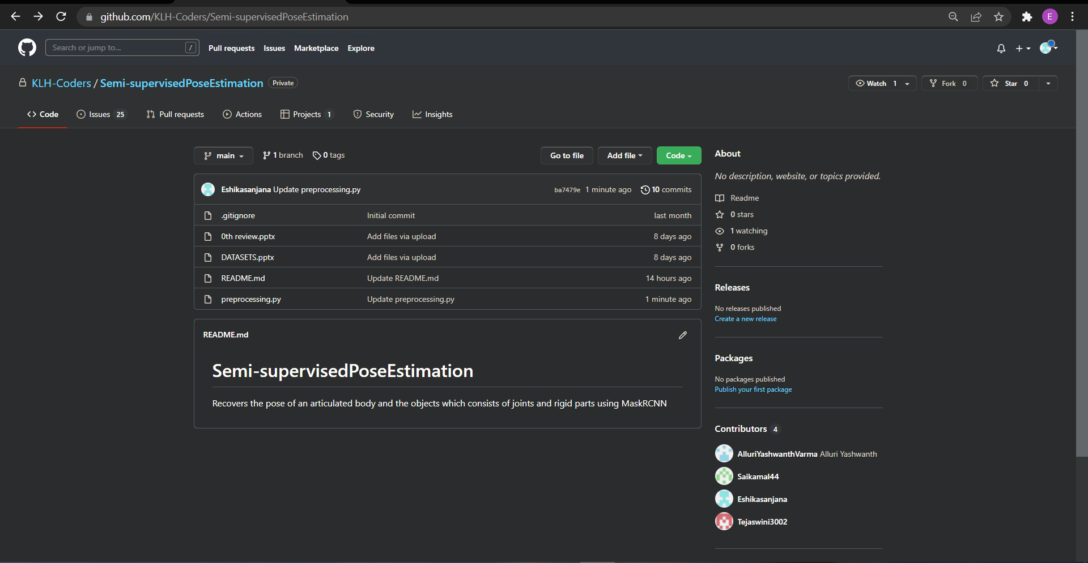
GITHUB COMMITS

Slide 17
Conclusion
Great strides have been made in the field of human pose estimation, which enables us to better serve the myriad applications that are possible with it. Moreover, research in related fields such as Pose Tracking can greatly enhance its productive utilization in several fields. The concepts listed in this blog are not exhaustive but rather strive to introduce some popular variants of these algorithms and their real-life applications.

Slide 18


